Slide 1
Welcome Everyone
01

Slide 2
Shazidul Alam Id: 09
Anisur Rahman Id: 15
Inheritance
Submitted to: Mondira Chakraborty
Submitted by:
Batch: CSE-19
Subject: Object oriented programming
02

Slide 3
Contents of This Template
Here’s what you’ll find in this template :
What is Inheritance?
Benefits of inheritance.
Inheritance Tree
Class Extend
Types of Class
Examples of using inheritance in Object Oriented Programming
Briefing
Significance
03

Slide 4
What is Inheritance?
Inheritance in Java is a mechanism that allows a class to acquire properties and behaviors from another class.
It enables code reuse by creating a hierarchy of classes, where subclasses inherit the characteristics (fields and methods) of a superclass.
The subclass, also known as the derived class or child class, can extend the functionality of the superclass by adding its own unique features or overriding inherited methods.
04

Slide 5
Benefits of Inheritance
01
Code reusability.
02
Promotes code organization.
03
Enables polymorphism.
04
Supports extensibility.
05

Slide 6
Uses of inheritance in Object Oriented programming.
1. Inheritance allows classes to inherit properties and behaviors from other classes, promoting code reuse and avoiding duplication.
2. Inheritance helps create a hierarchy of classes, making the codebase modular and easier to manage.
3. Inheritance enables objects of different classes to be treated as instances of a common superclass, promoting flexibility.
06

Slide 7
Inheritance Tree
Wooden Boat
Boat
Speed Boat
Water Transport
Battle Ship
Ship
Carrier Ship
07

Slide 8
Class Extend
a) "class extends" in Java is a mechanism used to establish an inheritance relationship between classes.
b) It allows a subclass to inherit the properties and behaviors of a superclass.
c) By extending a class, the subclass gains access to the public and protected members of the superclass, enabling code reuse and promoting hierarchy formation.
08

Slide 9
Example of Class Extend
class Water Transport{…….};
class Ship extends water transport{…….};
class Battle Ship extends water transport{…….};
09

Slide 10
Types of Class
Generally there are 2 types of classes in inheritance.
Whom are:
* Super class which is also known as base class.
* Sub class which is also known as derived class.
10

Slide 11
Superclass
a) A superclass, also known as a base class or parent class, is the class from which other classes inherit properties and behaviors.
b) It serves as a template or blueprint for creating derived classes, known as subclasses or child classes.
c) The superclass contains common attributes and methods that can be shared and inherited by its subclasses, promoting code reuse and providing a foundation for creating specialized classes.
Ship
↑
Battle ship
11

Slide 12
Subclass
a) A subclass, also known as a derived class or child class, is a class that extends or inherits from a superclass.
b) It inherits the fields and methods of the superclass, allowing for code reuse and providing a foundation to add additional features or modify inherited functionality.
c) The subclass can also override inherited methods to provide its own implementation or introduce new methods specific to its needs.
Ship
↑
Battle ship
12

Slide 13
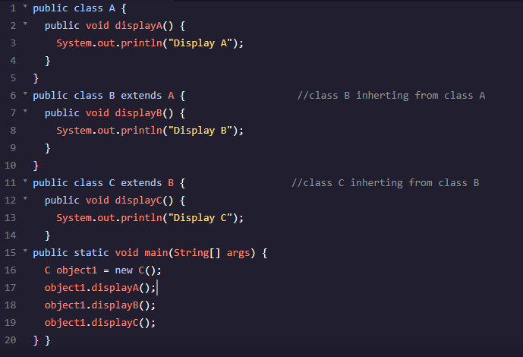
Example 1 of using inheritance in Object Oriented Programming :
Credits: Multi-Level Inheritance by Priya Pedakamkar
13

Slide 14
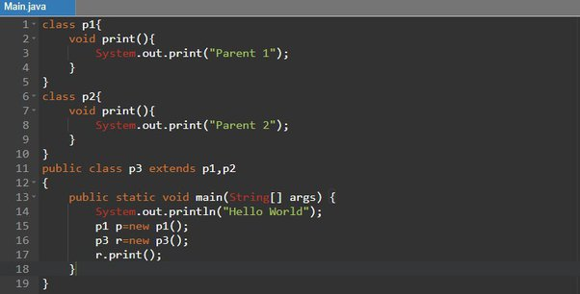
Examples 2 of using inheritance in Object Oriented Programming :
Credits: Thanks to Mouli Swaroop Paila
14

Slide 15
Briefing about inheritance
We can create a class ladder using the keyword extends.
The super class inherits all the data and methods of parent class.
***In a word inheritance allows us to reuse classes through calling them using extends.
15

Slide 16
System of modifying using inheritance
Adding methods mainly is a wonderful trick of modifying class.
A derived can be wonderfully tailored by adding new properties and specially functions as said earlier.
***After all software reuse is the main purpose of inheritance.
16

Slide 17



Inheritance significance in real life code
Faster implementation
Ease of use
Less debugging
17

Slide 18
Significance
Fast implementation helps a programmer by not writing the same code again from scratch.
If someone is familiar with the base class, then the derived class will be easy to understand.
The headache of debugging reduces to quite an contentment level.
18

Slide 19
Finals words
Last but not the least compactness, code becomes more compact to use and understand.
This codes are often easy to maintain better than lengthy and messy codes.
19

Slide 20
The End
20

